Slide 1


Particle collector
PRESENTED BY:
Elsmen Aragon

Slide 2
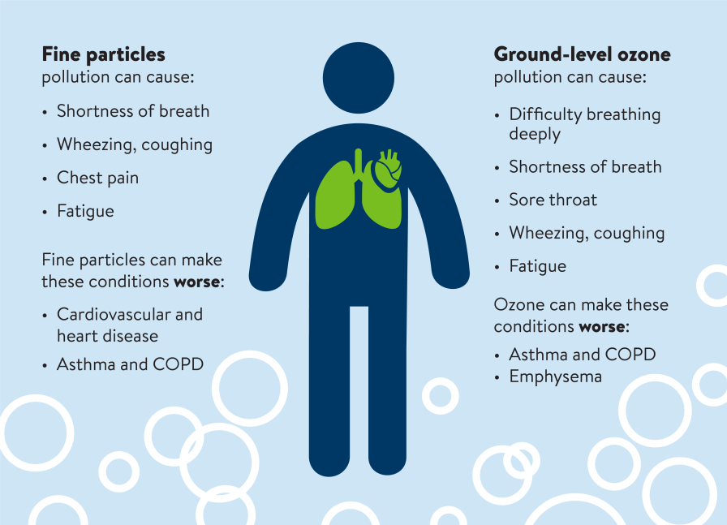
Health
https://www.pca.state.mn.us/air-water-land-climate/air-quality-and-health

Slide 3
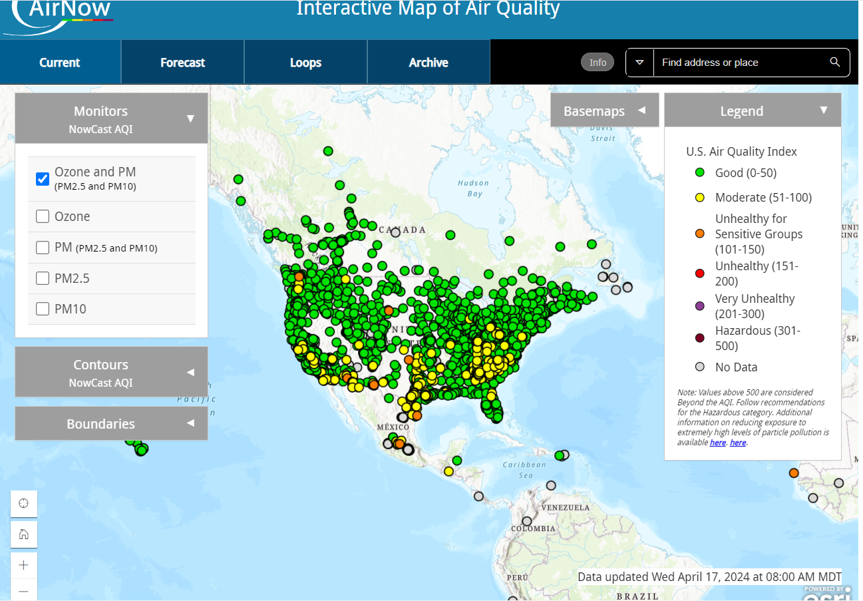
Air quality Monitoring
Ground-level Ozone (O₃)
Fine Particulate Matter (PM_{2.5})
Coarse Particulate Matter (PM₁₀)
Sulfur dioxide (SO₂)
Nitrogen dioxide (NO₂)
https://www.cabq.gov/airquality/air-quality-monitoring

Slide 4
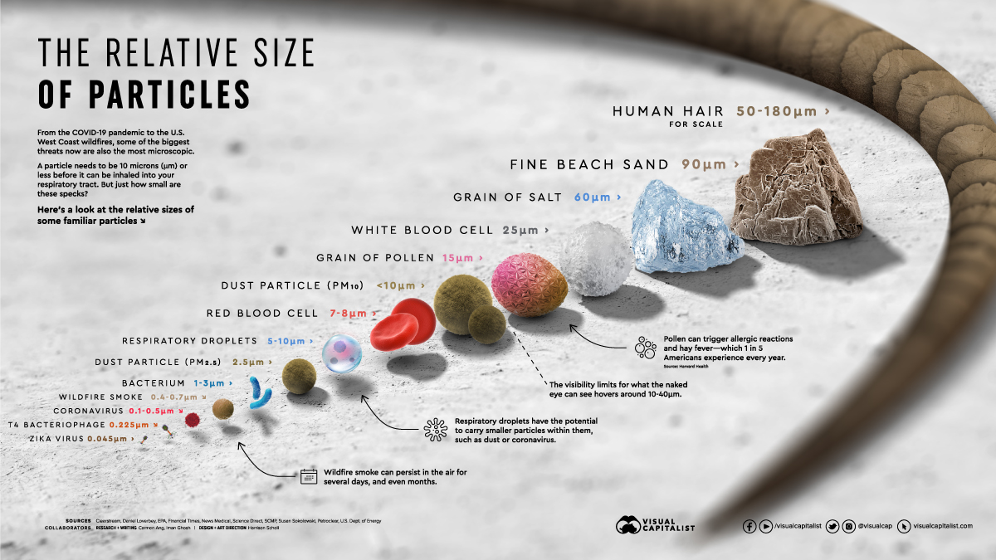


Slide 5

purpose
Public Health Protection
Urban Planning and Infrastructure Development
Industrial Compliance Monitoring:
Environmental Conservation
Early Warning Systems for Natural Disasters
Climate Change Research
Public Awareness and Education
Economic Impact Assessment:

Slide 6
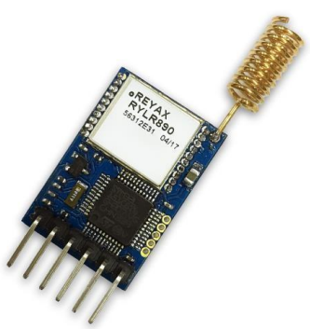
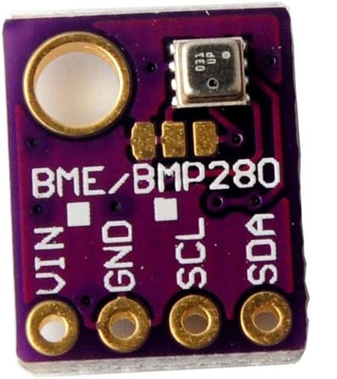
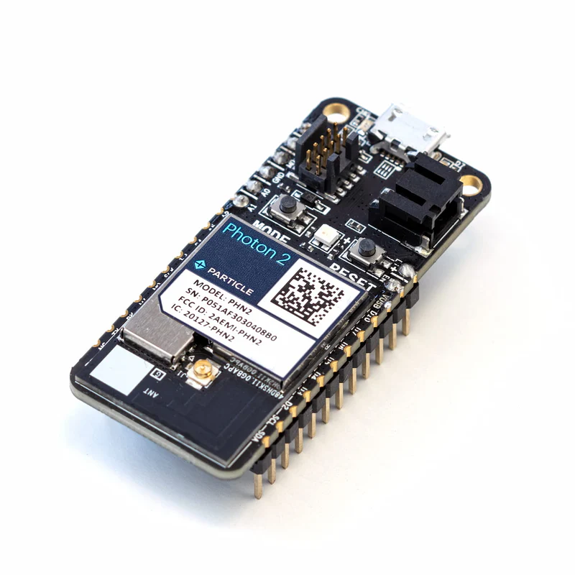
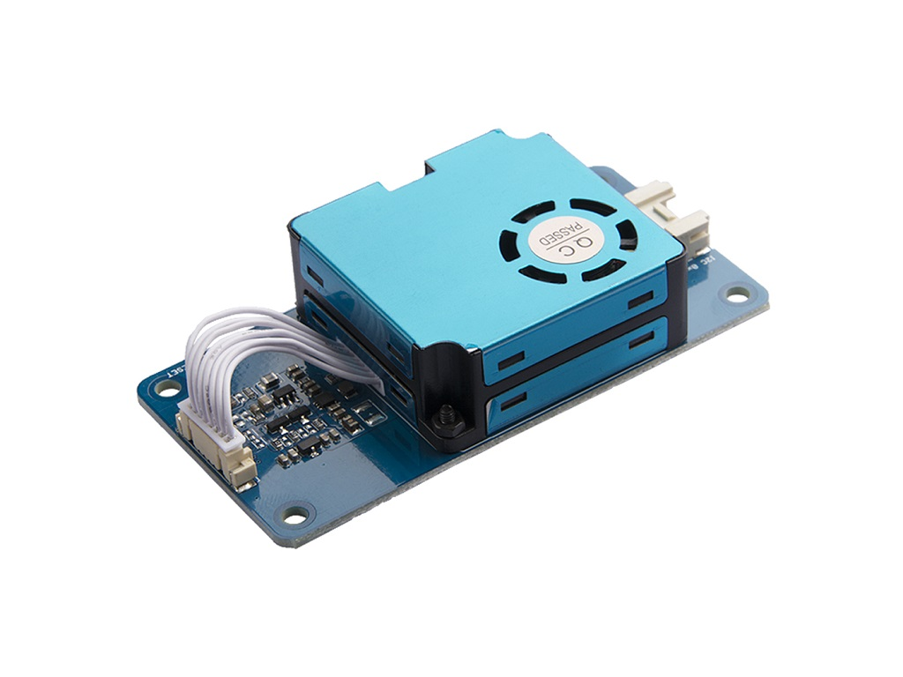
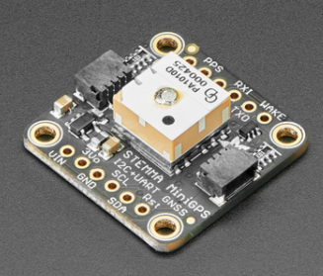
LoRa is a spread spectrum modulation technique for Low Power Wide Area Network (LPWAN).
BME280
LoRa
Mini GPS
Description | Range
868/915MHz LoRa Antenna Transceiver Module | 4-15 KM
Mini GPS | 60,000ft
HM3301 | 0.3µm、0.5µm、1.0µm、2.5µm、5µm、 10µ
Photon2 | -

Slide 7
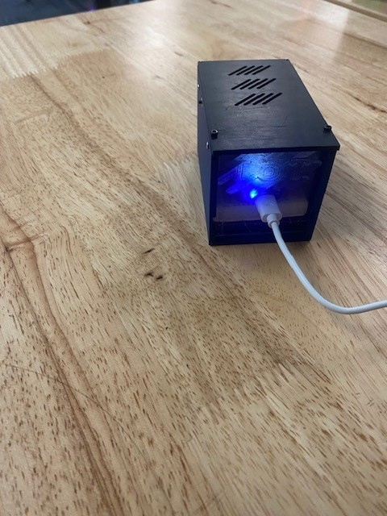
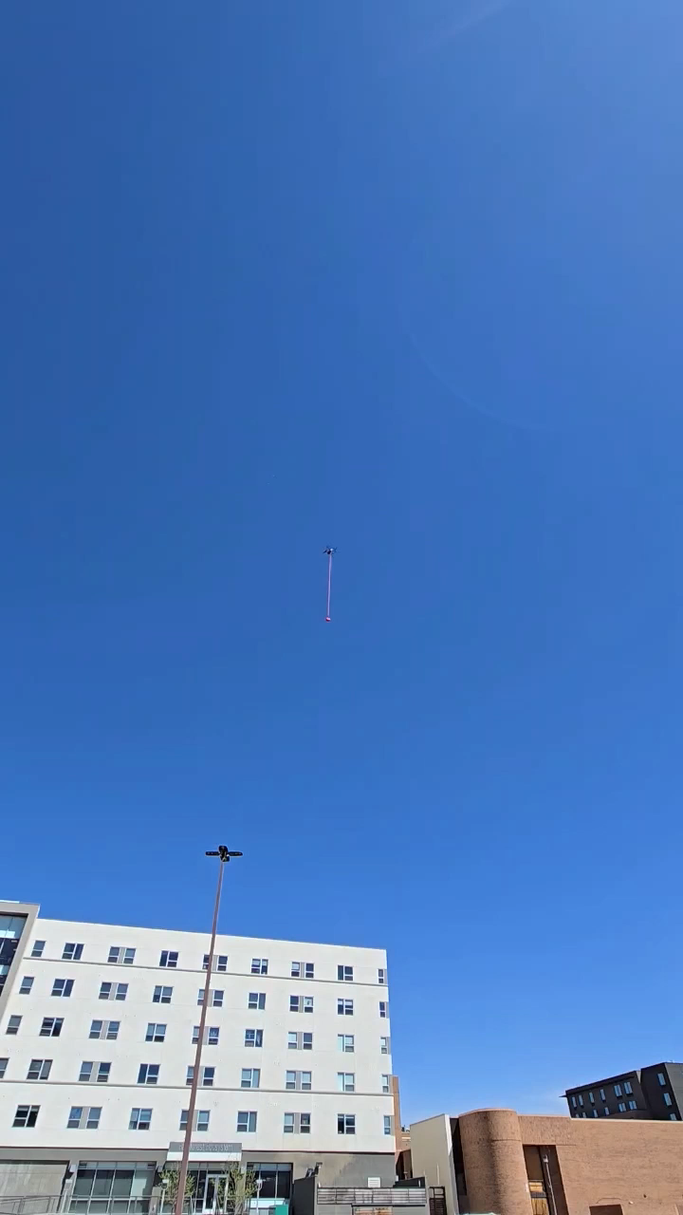
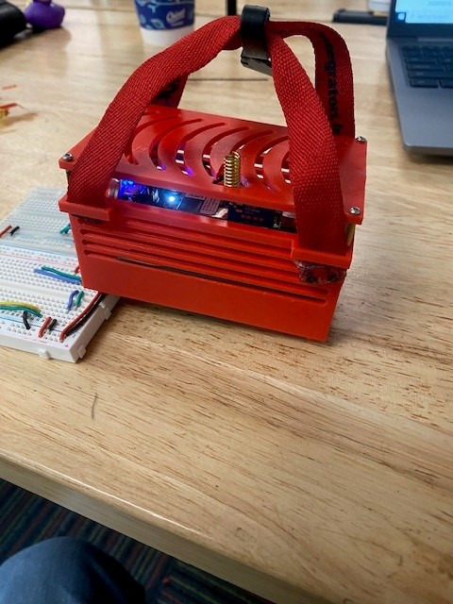
In flight

Slide 8

THANK YOU
Elsmen Aragon
Github link
Elsmen6@hotmail.com
www.linkedin.com/in/elsmen-aragon

